Slide 1
Course Outcomes
Create an interactive web pages using program. (Ch1 - Basic of Javascript)
Implement Arrays and functions in Java script. ( Ch 2 - Array,functions and String)
Create event based web forms using Java script (Ch 3 - Form and Event Handling)
Use Java script for handling cookies (Ch 4- Cookies and Browser Data)
Create interactive web page using regularexpressions for validation (Ch-5 Regular Expression, Rollover and Frames)
Lesson Outcomes –
1. Create an object to solve given problem
2. Develop Javascript to implement Swith-case Statement for given problem
3. Develop Javascript to implement loop for solving given iterative problem
4. Display properties for given object using getter and setter
5. Develop Program using basic features of Javascript to solve given problem

Slide 2
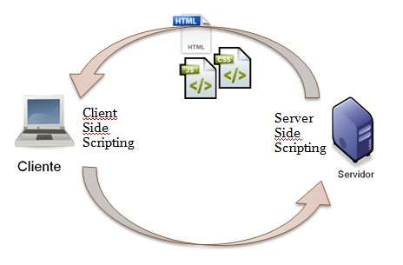
Unit 1
Basics of Javascript Programming
Course Outcome –
Create an interactive web pages using program.

Slide 3
What is scripting ?
A scripting language is used to write scripts.
These contain a series of commands that are interpreted one by one at runtime unlike programming languages that are compiled first before running.
Nowadays, scripts are generally associated with web development where they are widely used to make dynamic web applications.
Scripting languages can be divided into two categories: Server Side Scripting Languages
Client Side Scripting Languages -The Programming languages for client-side programming are :
Javascript
VBScript
HTML
CSS
AJAX

Slide 4
History of Javascript
JavaScript is a programming language for use in HTML pages
Invented in 1995 at Netscape Corporation (LiveScript) JavaScript has nothing to do with Java
JavaScript programs are run by an interpreter built into the user's web browser (not on the server)
Designed by Brendan Eich for Netscape.
It was originally called Mocha, renamed to LiveScript, and then renamed to JavaScript. the official standard is just called ECMAScript.

Slide 5
Features of Javascript
JavaScript can dynamically modify an HTML page
JavaScript can react to user input JavaScript can validate user input JavaScript can be used to create cookies JavaScript is a full-featured programming language
JavaScript user interaction does not require any communication with the server

Slide 6
Using Javascript in HTML
You can have any number of scripts
Scripts can be placed in the HEAD or in the BODY
In the HEAD, scripts are run before the page is displayed
In the BODY, scripts are run as the page is displayed
In the HEAD is the right place to define functions and variables that are used by scripts within the BODY
External Scripts
Scripts can also be loaded from an external file
This is useful if you have a complicated script or set of subroutines that are used in several different documents
<html>
<head>
<title>Hello World in JavaScript</title>
<script type="text/javascript"> function helloWorld() { document.write("Hello World!");
}
</script> </head><body>
<script type="text/javascript"> helloWorld(); </script> </body></html>
<script src="myscript.js"></script>
<html>
<head>
<title>Hello World in JavaScript</title>
</head>
<body>
<script type="text/javascript">
document.write("Hello World!");
</script>
</body>
</html>

Slide 7
Javascript Object Lesson Outcome - Create an object to solve given problem
JavaScript is object-oriented and uses the same method-calling syntax as Java
document.write("Hello World!");
Javascript objects are collection of properties and methods Properties - value or set of values
metode – Function
Property
data associated wth an object Each objevt has its own set of properties
A Property is key:value pair var user =
{ fname: "Manaswini",
lname: "Parlikar"};
Method
Action performed by object
Dot Syntax
Properties and Methods of object can be accessed using dot syntax user.fname
Var student = {fname=“Manaswini”, lname= "Parlikar", id = 17 , fullname: function() { return this.fname + " " + this.lname} };

Slide 8
Formative Assessment 1 Lesson Outcome - Create an object to solve given problem
Which Operator is used to access properties of object
dot operator 2. arrow operator 3. + operator 4. - operator
An ……………………… is a comma separated list of colon separated name: value pair is, enclosed within curly braces.
object prototype 2. object literal 3. object class 4. associative arrays
var Person = {fname:"Manaswini",lname:"Parlikar", age:40};
delete Person.age;
document.write(Person.age);
What is the output of the code?
Undefined 2. 40 3. Not available 4. Syntax Error

Slide 9
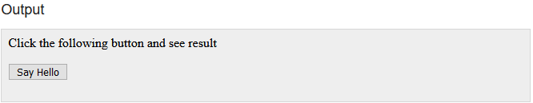
Main Event
JavaScript's interaction with HTML is handled through events that occur when the user or the browser manipulates a page.
Events are a part of the Document Object Model (DOM) and every HTML element contains a set of events which can trigger JavaScript Code.
<body>
<p>Click the following button and see result</p>
<form>
<input type = "button" onclick = "sayHello()" value = "Say Hello" />
</form>
</body>

Slide 10
Javascript Values And Variables
Javascript uses 6 types of values:
Undefined, Null
Boolean, String, Number, and
Object
The primitive values are booleans, numbers, strings, null, and undefined.
Boolean – true, false
Numbers: 1736, 1.351
Strings: 'abc', "abc“
Two “nonvalues”: undefined, null
JavaScript has variables. Variables can be thought of as named containers.
Before you use a variable in a JavaScript program, you must declare it. Variables are declared with the var keyword
<script type = "text/javascript">
var money;
var name;
</script>
You can also declare multiple variables with the same var keyword as follows −
<script type = "text/javascript">
var money, name;
</script>

Slide 11
Javascript variables Cont…
Storing a value in a variable is called variable initialization.
<script type = "text/javascript">
var name = “Manaswini”;
</script>
JavaScript is untyped language.
This means that a JavaScript variable can hold a value of any data type.
Unlike many other languages, you don't have to tell JavaScript during variable declaration what type of value the variable will hold.
The value type of a variable can change during the execution of a program and JavaScript takes care of it automatically.
https://js.do/smanup2001/var_demo
The general rules for constructing names for variables (unique identifiers) are:
Names can contain letters, digits, underscores, and dollar signs.
Names must begin with a letter
Names can also begin with $ and _
Names are case sensitive (y and Y are different variables)
Reserved words (like JavaScript keywords) cannot be used as names

Slide 12
Javascript variable scope
Global Variables − A global variable has global scope which means it can be defined anywhere in your JavaScript code.
Local Variables − A local variable will be visible only within a function where it is defined. Function parameters are always local to that function.
<html>
<body onload = checkscope();>
<script type = "text/javascript">
var myVar = "global"; // Declare a global variable
function checkscope( )
{ var myVar = "local"; // Declare a local variable document.write(myVar);
}
</script> </body> </html>

Slide 13
Javascript Operators
Arithmetic Operators
Sr.No. | Operator & Description A holds 10 and variable B holds 20
1 | + (Addition) - Adds two operands Ex: A + B will give 30
2 | - (Subtraction) - Subtracts the second operand from the first Ex: A - B will give -10
3 | * (Multiplication) - Multiply both operands Ex: A * B will give 200
4 | / (Division) - Divide the numerator by the denominator Ex: B / A will give 2
5 | % (Modulus) - Outputs the remainder of an integer division Ex: B % A will give 0
6 | ++ (Increment) - Increases an integer value by one Ex: A++ will give 11
7 | -- (Decrement) - Decreases an integer value by one Ex: A-- will give 9

Slide 14
Javascript Operators - Comparison Operators
Sr.No. | Operator & Description A holds 10 and variable B holds 20
1 | = = (Equal) -Checks if the value of two operands are equal or not, if yes, then the condition becomes true. Ex: (A == B) is not true.
2 | != (Not Equal) - Checks if the value of two operands are equal or not, if the values are not equal, then the condition becomes true. Ex: (A != B) is true.
3 | > (Greater than) - Checks if the value of the left operand is greater than the value of the right operand, if yes, then the condition becomes true. Ex: (A > B) is not true.
4 | < (Less than) - Checks if the value of the left operand is less than the value of the right operand, if yes, then the condition becomes true. Ex: (A < B) is true.
5 | >= (Greater than or Equal to) - Checks if the value of the left operand is greater than or equal to the value of the right operand, if yes, then the condition becomes true. Ex: (A >= B) is not true.
6 | <= (Less than or Equal to) - Checks if the value of the left operand is less than or equal to the value of the right operand, if yes, then the condition becomes true. Ex: (A <= B) is true.

Slide 15
Javascript Operators - Logical Operators
Sr.No. | Operator & Description A holds 10 and variable B holds 20
1 | && (Logical AND) If both the operands are non-zero, then the condition becomes true. Ex: (A && B) is true.
2 | || (Logical OR) If any of the two operands are non-zero, then the condition becomes true. Ex: (A || B) is true.
3 | ! (Logical NOT) Reverses the logical state of its operand. If a condition is true, then the Logical NOT operator will make it false. Ex: ! (A && B) is false.

Slide 16
Javascript Operators - Bitwise Operators
Sr.No. | Operator & Description A holds 2 and variable B holds 3
1 | & (Bitwise AND) - It performs a Boolean AND operation on each bit of its integer arguments. Ex: (A & B) is 2.
2 | | (BitWise OR) - It performs a Boolean OR operation on each bit of its integer arguments. Ex: (A | B) is 3.
3 | ^ (Bitwise XOR) - It performs a Boolean exclusive OR operation on each bit of its integer arguments. Exclusive OR means that either operand one is true or operand two is true, but not both. Ex: (A ^ B) is 1.
4 | ~ (Bitwise Not) – It is a unary operator and operates by reversing all the bits in the operand. Ex: (~B) is -4.
5 | << (Left Shift) - It moves all the bits in its first operand to the left by the number of places specified in the second operand. New bits are filled with zeros. Shifting a value left by one position is equivalent to multiplying it by 2, shifting two positions is equivalent to multiplying by 4, and so on. Ex: (A << 1) is 4.
6 | >> (Right Shift) - Binary Right Shift Operator. The left operand’s value is moved right by the number of bits specified by the right operand. Ex: (A >> 1) is 1.
7 | >>> (Right shift with Zero) - This operator is just like the >> operator, except that the bits shifted in on the left are always zero. Ex: (A >>> 1) is 1.

Slide 17
Javascript Operators – Assignment Operators
Sr.No. | Operator & Description
1 | = (Simple Assignment ) - Assigns values from the right side operand to the left side operand Ex: C = A + B will assign the value of A + B into C
2 | += (Add and Assignment) It adds the right operand to the left operand and assigns the result to the left operand. Ex: C += A is equivalent to C = C + A
3 | −= (Subtract and Assignment) It subtracts the right operand from the left operand and assigns the result to the left operand. Ex: C -= A is equivalent to C = C - A
4 | *= (Multiply and Assignment) It multiplies the right operand with the left operand and assigns the result to the left operand. Ex: C *= A is equivalent to C = C * A
5 | /= (Divide and Assignment) It divides the left operand with the right operand and assigns the result to the left operand. Ex: C /= A is equivalent to C = C / A
6 | %= (Modules and Assignment) It takes modulus using two operands and assigns the result to the left operand. Ex: C %= A is equivalent to C = C % A

Slide 18
Javascript Operators – Miscellaneous Operator
Conditional operators Conditional Operator (? :)
The conditional operator first evaluates an expression for a true or false value and then executes one of the two given statements depending upon the result of the evaluation.
Typeof operators
The typeof operator is a unary operator that is placed before its single operand
Sr.No | Operator and Description
1 | ? : (Conditional ) If Condition is true? Then value X : Otherwise value Y

Slide 19
Object , Array and Function
Array Initializer – []
var a = [1,2,3];
Object Initializer - {}
var p = {x:2.3, y:-1.2}
Property access Expression :
For the object using . (dot)
p.x
For array using [expression]
a[0]
Function
Use keyword function followed by comma- separated list of zero or more parameter in the parentheses.
var square = function(x) { return x*x ;)
Invocation Expression
Used for calling function or method
find(); // find previously defined function

Slide 20
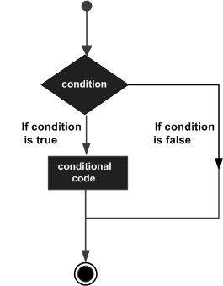
Conditional Statements – if- else
Different forms of if-else
if statement
if...else statement
if...else if... Statement
Syntax
if (expression)
{ Statement(s) to be executed if expression is true }
if (expression)
{ Statement(s) to be executed if expression is true }
else
{ Statement(s) to be executed if expression is false }
if (expression 1)
{ Statement(s) to be executed if expression 1 is true }
else if (expression 2)
{ Statement(s) to be executed if expression 2 is true }
else if (expression 3)
{ Statement(s) to be executed if expression 3 is true }
else
{ Statement(s) to be executed if no expression is true }

Slide 21
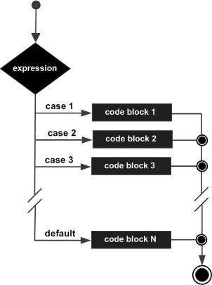
Conditional Statements - Switch-case LO 2 - Develop Javascript to implement Swith-case Statement for given problem
switch (expression)
{
case condition 1:
statement(s) break;
case condition 2:
statement(s) break;
...
case condition n:
statement(s) break;
default: statement(s)
}

Slide 22
Formative Assessment- 2 LO – 2 Develop Javascript to implement Swith-case Statement for given problem
Q.1 When statements in default will be executed?
When all cases are true , 2. If none of case matches 3. At the beginning of the switch case 4. At the end of switch case
Q.2 Switch case statement break is compulsory statement for each case.
True 2. False
Q.3 What will be the output of the code?
var selection = 1;
switch (selection)
{ case 1:
document.write(“You entered 1”);
case 2:
document.write(“You entered 2”);
break;
default:
document.write(“Not matching”);
}
You entered 1 2. You entered 1 You entered 2 3. Not matching 4. You entered 1 You entered 2 Not matching

Slide 23
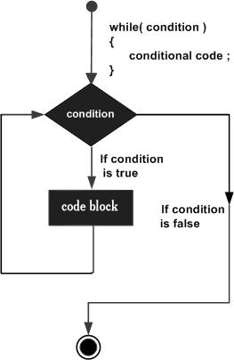
Loop Statement – while LO – 3 Develop Javascript to implement loop for solving given iterative problem
The purpose of a while loop is to execute a statement or code block repeatedly as long as an expression is true. Once the expression becomes false, the loop terminates.
while (expression)
{
Statement(s) to be executed
if expression is true
}
while (expression)
{
Statement(s) to be executed
if expression is true
}

Slide 24
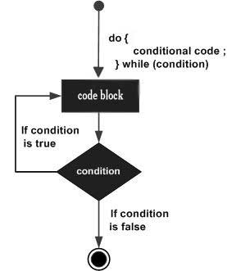
Loop Statement – do -while
The do...while loop is similar to the while loop except that the condition check happens at the end of the loop. This means that the loop will always be executed at least once, even if the condition is false.
do {
Statement(s) to be executed;
} while (expression);

Slide 25
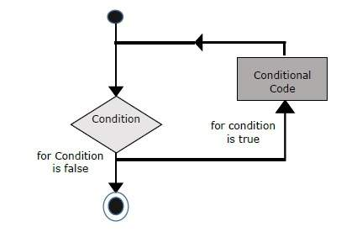
Loop Statement – for
Three important part of for loop
The loop initialization where we initialize our counter to a starting value. The initialization statement is executed before the loop begins.
The test statement which will test if a given condition is true or not. If the condition is true, then the code given inside the loop will be executed, otherwise the control will come out of the loop.
The iteration statement where you can increase or decrease your counter.
for (initialization; test condition; iteration statement)
{ Statement(s) to be executed if test condition is true }

Slide 26
Loop Statement – for - in
for (variablename in object)
{ statement or block to execute }

Slide 27
Formative Assessment 3 LO – 3 Develop Javascript to implement loop for solving given iterative problem
Q.1 What is syntax of for loop?
for(initialization;condition;inc/dec) 2. for(condition;inc/dec) 3. for(initialization;condition) 4. for(condition)
Q.2 Which loop will be executed atleast once?
do….while 2. While 3. For 4. for in loop
Q.3 What will be the output of the prog?
var i=1;
do
{
document.write(“Inside Loop”);
}while(i>10);
What will be the output of the prog?
Inside Loop 2. Nothing will be printed as condition is false 3. syntax error 4. Print Inside loop 10 times.

Slide 28
Break and Continue
There may be a situation when you need to come out of a loop without reaching its bottom.
There may also be a situation when you want to skip a part of your code block and start the next iteration of the loop.
Break statement:
It is used to exit a loop early, breaking out of the enclosing curly braces.
Continue Statement:
The continue statement tells the interpreter to immediately start the next iteration of the loop and skip the remaining code block.

Slide 29
Break Example
<html>
<body>
<script type = "text/javascript">
<!-- var x = 1;
document.write("Entering the loop<br /> ");
while (x < 20) {
if (x == 5) {
break; // breaks out of loop completely
}
x = x + 1;
document.write( x + "<br />");
}
document.write("Exiting the loop!<br /> ");
//--> </script>
<p>Set the variable to different value and then try...</p>
</body>
</html>

Slide 30
Continue Example
<html>
<body>
<script type = "text/javascript">
var x = 1;
document.write("Entering the loop<br /> ");
while (x < 10) {
x = x + 1;
if (x == 5) {
continue; // skip rest of the loop body
}
document.write( x + "<br />");
}
document.write("Exiting the loop!<br /> ");
</script>
<p>Set the variable to different value and then try...</p>
</body>
</html>

Slide 31
Getting, Setting and Deleting Properties
<script>
var Person = {fname:"Manaswini",lname:"Parlikar", age:40};
</script>
Getting Properties :
Var $Myname = Person.fname;
Setting Properties:
Person.fname = “Abc”;
Person.age = 45;
Deleting Property:
delete Person.age;

Slide 32
Property Getter and Setter LO – 4 Display properties for given object using getter and setter
To avoid accessibility of data from outside world we will use getter and setter.
3 ways -
With methods
Since getters and setters are basically functions that fetch/change a value
var obj = {
foo: 'this is the value of foo',
getFoo: function() {
return this.foo;
},
setFoo: function(val) {
this.foo = val;
}
}
document.write(obj.getFoo());
obj.setFoo('hello');
Document.write(obj.getFoo());

Slide 33
Property Getter and Setter
With keywords
To create a getter, place the get keyword in front of a function declaration that will serve as the getter method
use the set keyword in the same way to create a setter
var obj = {
fooVal: 'this is the value of foo',
get foo() {
return this.fooVal;
},
set foo(val) {
this.fooVal = val;
}
}
console.log(obj.foo);
obj.foo = 'hello';
console.log(obj.foo);

Slide 34
Property Getter and Setter – With keyword cont…
If you choose to create getters and setters with keywords, you can use the assignment operator to set the data and the dot operator to get the data, the same way you’d access/set the value of a regular property.
if you choose the first way of coding getters and setters, you have to call the setter and getter methods using the function call syntax because they are typical functions (nothing special like those created using the get and set keywords).
Also, there’s a chance you might end up accidentally assigning some other value to the properties that held those getter-setter methods and lose them completely! Something you don’t have to worry about in the later method.
If for some reason you prefer the first technique, make the properties holding the getter-setter methods read-only by creating them using Object.defineProperties. Properties created via Object.defineProperties, Object.defineProperty and Reflect.defineProperty automatically configure to writable: false which means read-only.
/* Overwrite prevention */
var obj = {
foo: 'this is the value of foo'
};
Object.defineProperties(obj, {
'getFoo': {
value: function () {
return this.foo;
}
},
'setFoo': {
value: function (val) {
this.foo = val;
}
}
});
obj.getFoo = 66;
console.log(obj.getFoo());

Slide 35
Formative Assessment 4 LO – 4 Display properties for given object using getter and setter
Q.1 Which keywords are used to define accessor properties of object?
new,delete 2. get,set 3. in,out 4. set,unset
Q.2 The ……………………… attribute of an object specifies whether the value of the property can be set.
Readable 2. Writable 3. Enumerable 4. Configurable
Q. 3 Which code will make it readonly?
var Person = {
fname:Manaswini,
}
By adding only get fname() 2. By adding only set fname() 3. By adding bot get fname() and setfname() 4. By doing nothing

Slide 36
Formative Assessment 5 LO – 5 Develop Program using basic features of Javascript to solve given problem
Q.1 JavaScript Code is written inside file having extension __________.
.jvs
.js
.javascript
.jsc
Q.2 JavaScript is designed for following purpose
To Style html page
To add interactivity to html pages
To perform server side Scripting operation
To execute Query related to DB Server
Q. 3 Following code is Correct or not
<html><head><title>My Page</title>
</head>
<body>
<a href="javascript:myFunction();">Click here</a>
<script language="javascript" type="text/javascript">
function myFunction() {
alert('Hello world');
}
</script>
</body>
1. Yes 2. No.

Slide 37
Summative assessment CO - Create an interactive web pages using program.
Q. 1. Which of the following Attribute is used to include External JS code inside your HTML Document
Script 2. Link 3. Ext 4. Src
Q.2 We can embed JS code inside HTML directly ?
True 2. False
Q.3 What is output of following code
<html><body>
<script type="text/javascript">
<!--
document.print("Hello");
//-->
</script>
</body></html>
will throw error 2. Hello 3. will not print anything due to comment 4. None of these
Q.4 What are the three important manipulations done in a for loop on a loop variable in javascript?
1. the initialization, the Incrementation, and update 2. the initialization, the test, and the update 3. the initialization, the test, and Incrementation 4. All of the above
Q. 5. JS code included inside head section is loaded before loading page.
1. True 2. False

Slide 38
Practice Worksheet
Write Answers for the following questions in the notebook
List any four features of Java script
Explain getter and setter properties in Java script with suitable example
Write Java script to create person object with properties firstname, lastname, age, eye color, delete eye color property and display remaining properties of person object
Write a Java script program which computes, the average marks of 5 students then, this average is used to determine the corresponding grade.
State the use of dot syntax in JavaScript with the help of suitable example.
List and explain Logical operators in JavaScript.
Write syntax of and explain prompt method in JavaScript with the help of suitable example.
Write a program to print sum of even numbers between 1 to 100 using for loop.
Write a JavaScript that displays first 20 even numbers on the document window.
Describe all the tokens of the following statements :
i. document.bgColor
ii. document.write()

Slide 39
Study Material
Reference Book : Javascript Demystified
Create an object to solve given problem - Pg No 4
Develop Javascript to implement Swith-case Statement for given problem – Pg No 58
Develop Javascript to implement loop for solving given iterative problem – Pg. No. 62
Display properties for given object using getter and setter -
Develop Program using basic features of Javascript to solve given problem

Slide 40
Answer Keys
Formative Assessment 1
Question No 1 - Dot operator (.)
Question No 2 - associative arrays
Question No 3 – undefined
Formative Assessment 2
Question No 1 - If none of case matches
Question No 2 – false
Question No 3 – You entered 1 You entered 2
Formative Assessment 3
Question No 1 - for(initialization;condition;inc/dec)
Question No 2 – do…while
Question No 3 – Inside Loop
Formative Assessment 4
Question No 1 - get,set
Question No 2 – writable
Question No 3 – By adding only get fname()
Formative Assessment 5
Question No 1 - .js
Question No 2 – To add interactivity to html pages
Question No 3 – Yes

